Slide 1
Choosing a Form of Business Ownership

Slide 2
Learning Objectives
4-1 Describe the advantages and disadvantages of sole proprietorships.
4-2 Explain the different types of partners and the importance of partnership agreements.
4-3 Describe the advantages and disadvantages of partnerships.
4-4 Summarize how a corporation is formed.
4-5 Describe the advantages and disadvantages of a corporation.

Slide 3
Learning Objectives (continued)
4-6 Examine special types of corporations, including S-corporations, limited-liability companies, and not-for-profit corporations.
4-7 Discuss the purpose of a cooperative, joint venture, and syndicate.
4-8 Explain how growth from within and growth through mergers can enable a business to expand.

Slide 4

Sole Proprietorship
A business owned and (usually) operated
by one person
Simplest form of business ownership
The most popular form
of business ownership
Many large businesses
began as small
struggling sole
proprietorships

Slide 5
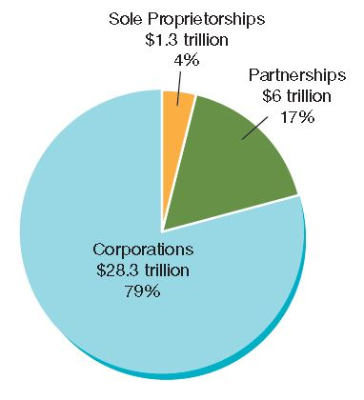
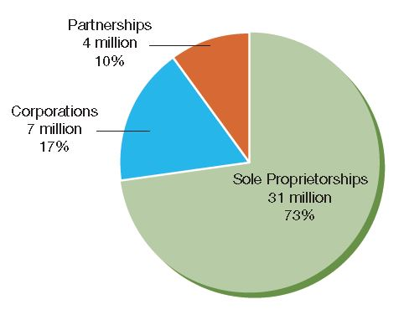
Sole Proprietorships in Comparison
Relative Percentages of Sole Proprietorships, Partnerships, and Corporations in the United States
Total Sales Receipts of Sole Proprietorships, Partnerships, and Corporations in the Unites States
Source: “Statistics of Income,” The Internal Revenue Service website at www.irs.gov (accessed January 5, 2014).

Slide 6
Sole Proprietorship:
Advantages and Disadvantages
Advantages
Ease of start-up and closure
Pride of ownership
Retention of all profits
No special taxes
Flexibility of being your own boss
Disadvantages
Unlimited liability
Lack of continuity
Lack of money
Limited management skills
Difficulty in hiring employees

Slide 7

Sole Proprietorship: Unlimited Liability
Unlimited liability is a legal concept that holds a business owner personally responsible for all the debts of the business
This is the major factor discouraging the use of sole proprietorship

Slide 8
Class Exercise
You want to own and manage your own business.
To help you evaluate your chances of success, answer these questions.
Do you have any experience in a business like the one you want to start?
Have you worked for someone else as a supervisor or manager?
Have you saved any money? How much?
Do you know how much money you will need to get your business started?
Do you know how much credit you can get from your suppliers and bankers?
Do you know the good and bad points about going it alone, having a partner, and incorporating your business?
What do you know about your potential customer?
Notes:
One option for setting up this activity is to have students form groups around common ideas and work through these questions in their group, coming to a consensus. These groups may form the basis for creating a business plan and model going forward.

Slide 9

Partnership
A partnership is a voluntary association of two or more persons to act as co-owners of a business for profit
Usually a pooling of special talents or the result of a sole proprietor taking on a partner
No legal limit on the maximum number of partners; most have only two
Large accounting, law, and advertising partnerships have multiple partners
Less common form of ownership than sole proprietorship or corporation

Slide 10
Types of Partners
A general partner is a person who assumes full or shared responsibility for operating a business
A limited partner is a person who invests money in a business but who has no management responsibility or liability for losses beyond his or her investment in the partnership
General partners have management responsibility and liability for all losses
Limited partners have no management responsibility and no liability for losses beyond their investment

Slide 11
The Partnership Agreement
Articles of partnership refers to an agreement listing and explaining the terms of the partnership; written is preferable to oral
Agreement should state
  Who will make final decisions
  What each partner’s duties will be
  The investment each partner will make
  How much profit or loss each partner receives or is responsible for
  What happens if a partner wants to dissolve the partnership or dies

Slide 12
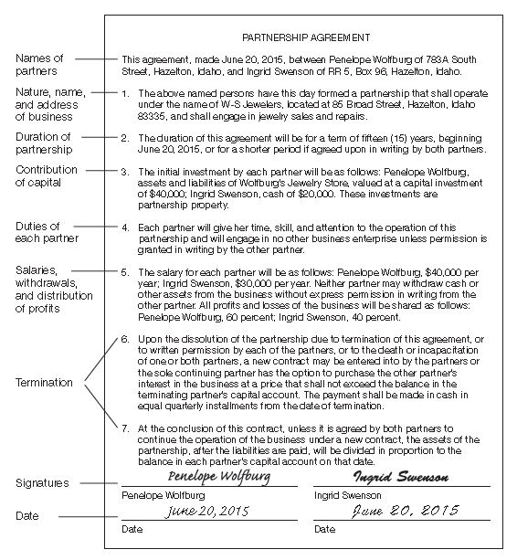
Articles of Partnership
Source: Adapted from Goldman and Sigismond, Cengage Advantage Books: Business Law 9E.

Slide 13

Advantages and Disadvantages of Partnerships
Advantages
Ease of start-up
Availability of capital and credit
Personal interest
Combined business skills and knowledge
Retention of profits
No special taxes
Disadvantages
Unlimited liability
Management disagreements
Lack of continuity
Frozen investment

Slide 14

Corporations
A corporation is an artificial person created by law with most of the legal rights of a real person, including the rights to start and operate a business, to buy or sell property, to borrow money, to sue or be sued, and to enter into binding contracts
Exists only on paper
Approx. 6 million in the
United States
19% of all businesses
82% of sales revenue
Notes:
Additional Resources
Reuters
The Great Debate: Citizens United
http://blogs.reuters.com/great-debate/tag/citizens-united/
Citizens United v. Federal Election Commission
http://www.supremecourt.gov/opinions/09pdf/08-205.pdf

Slide 15
Corporate Ownership: Stock
Stock: The shares of ownership of a corporation
Stockholder: A person who owns a corporation's stock
Closed Corporation: Stock is owned by relatively few people and not sold to public
Open Corporation: Stock is bought and sold on security exchanges and can be bought by anyone

Slide 16
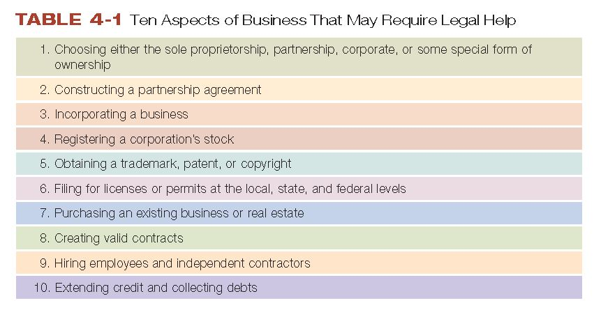
Forming a Corporation
Experts suggest you consult a lawyer when deciding to incorporate and throughout the process

Slide 17
Forming a Corporation:
Where to Incorporate
A business can incorporate in any state it chooses
The decision is usually based on cost and the advantages and disadvantages of each state’s corporate laws and tax structure
A domestic corporation is a corporation in the state in which it is incorporated
A foreign corporation is a corporation in any state
in which it does business except the one in which
it is incorporated
An alien corporation is a corporation chartered by a foreign government and conducting business in the United States
Notes:
Additional Resources
Website:
Incorp information about incorporating in Nevada, Wyoming, and Delaware
http://www.incorp.com/where-to-incorporate.aspx
Video
Entrepreneur Online
3 Reasons to Incorporate Your Business
1:11
https://www.youtube.com/watch?v=doTPnVmj61k
How to Know in Which State to Incorporate Your Business
Argument against incorporating outside your home state
1:09
https://www.youtube.com/watch?v=TI-BEEgQANs

Slide 18
Forming a Corporation:
The Corporate Charter
Articles of incorporation: a contract between the corporation and the state in which the state recognizes the formation of the artificial person that is the corporation
  Firm’s name and address
  Incorporators’ names and addresses
  Purpose of the corporation
  Maximum amount of stock and types of stock to be issued
  Rights and privileges of stockholders
  Length of time the corporation is to exist

Slide 19

Forming a Corporation: Types of Stock
Common Stock
    Stock owned by individuals or firms who may vote on corporate matters but whose claims on profit and assets are subordinate to the claims of others
Preferred Stock
    Stock owned by individuals or firms who usually do not have voting rights but whose claims on dividends are paid before those of common-stock owners

Slide 20
Forming a Corporation: Dividend
    Dividend: A distribution of earnings to the stockholders of a corporation
    Proxy: A legal form listing issues to be decided at a stockholders’ meeting and enabling stockholders to transfer their voting rights to some other individual or individuals

Slide 21
Forming a Corporation:
Organizational Meeting
The organizational meeting is the last step in forming a corporation
  The incorporators and original stockholders meet to adopt corporate by-laws and elect their first board of directors
Board members are directly responsible to stockholders for how they operate the firm

Slide 22
Corporate Structure: Board of Directors
The top governing body of a corporation, the members of which are elected by the stockholders
Responsible for setting corporate goals, developing strategic plans to meet those goals, and the firm’s overall operation
Outside directors: experienced managers or entrepreneurs from outside the corporation who have specific talents
Inside directors: top managers from within the corporation
Notes:
Additional Resources
Article
Forbes
The New Class of Female CEOs
8/22/2012
http://www.forbes.com/sites/carolinehoward/2012/08/22/introducing-the-new-class-of-female-ceos/
Wall Street Journal
How Women Can Get Ahead: Advice from female CEOs
5/18/2012
http://online.wsj.com/article/SB10001424052702303879604577410520511235252.html

Slide 23

Corporate Structure: Corporate Officers
The chairman of the board,
president, executive vice
presidents, corporate
secretary, treasurer, and
any other top executive
appointed by the board
Responsible for implementing the chosen strategy and directing the work of the corporation, periodically reporting results to the board and stockholders

Slide 24

Hierarchy of Corporate Structure
Stockholders exercise a great deal of influence through their right to elect the board of directors

Slide 25
Advantages and Disadvantages of Corporations
Advantages
Limited liability – each owner's financial liability is limited to the amount of money that he or she has paid for stock
Ease of raising capital
Ease of transfer of ownership
Perpetual life
Specialized management
Disadvantages
Difficulty and expense of formation
Government regulation and increased paperwork
Conflict within the corporation
Double taxation
Lack of secrecy

Slide 26
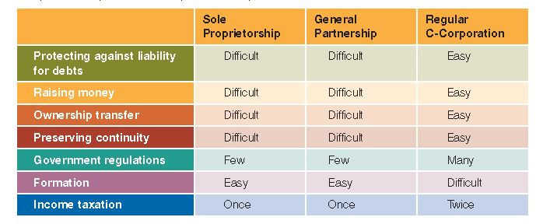
Advantages and Disadvantages of a Sole Proprietorship, Partnership, and Corporation

Slide 27
Special Types of Business Ownership:
S-Corporations
A corporation that is taxed as if it were a partnership
(income taxed as personal income of stockholders)
Advantages
  Avoids double taxation of a corporation
  Retains the corporation’s legal benefit of limited liability
S-corporation criteria
  No more than 100 stockholders allowed
  Stockholders must be individuals, estates, or certain trusts
  There can be only one class of outstanding stock
  The firm must be a domestic corporation
  No partnerships, corporations, or nonresident-alien stockholders
  All stockholders must agree to form an S-corporation

Slide 28
Special Types of Business Ownership:
Limited-liability Company (LLC)
Form of business ownership combining the benefits
of a corporation and partnership but avoids some of restrictions and disadvantages
Advantages
  Avoids double taxation of a corporation
  Retains the corporation’s legal benefit of limited liability
  Provides more management flexibility
Difference between LLC and S-corporation
  LLCs not restricted to 100 stockholders
  LLCs have fewer restrictions on who can be a stockholder

Slide 29
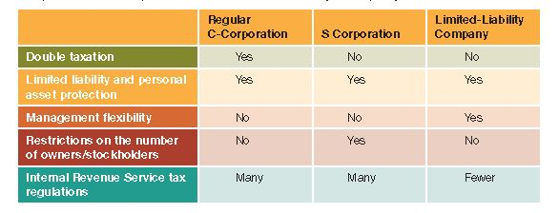
Advantages and Disadvantages of a Regular Corporation, S-Corporation,
Limited-Liability Company

Slide 30
Special Types of Business Ownership:
Not-for-profit Corporations
Not-for-profit corporations are organized to provide social, educational, religious, or other services, rather than to earn a profit
Charities, museums, private schools, colleges, and charitable organizations are organized as not-for-profits primarily to ensure limited liability
Must meet specific IRS guidelines to obtain tax-exempt status
Notes:
Additional Resources
Blog
Branded Out Loud: Straight Talk about Branding & Marketing Your Nonprofit
12 Nonprofits Putting Infographics to Work
9/7/2012
http://branded4good.com/blog/nonprofit-communication/12-nonprofits-putting-infographics-good/
Website
Idealist.org
Resources for Nonprofits
http://www.idealist.org/info/Nonprofits
USA.gov for Nonprofits
http://www.usa.gov/Business/Nonprofit.shtml

Slide 31

Joint Ventures and Syndicates
Joint ventures are agreements between two or more groups to form a business entity in order to achieve a specific goal or to operate for a specific period of time
Syndicates are temporary associations of individuals or firms organized to perform a specific task that requires a large amount of capital
  Most commonly used to underwrite large insurance policies, loans, and investments
© pichetw/Shutterstock.com

Slide 32
Corporate Growth from Within
Most corporations grow by expanding their present operations
  New but related products
  Expand sales of present products
When carefully controlled and planned, has little adverse effect on firm

Slide 33
Corporate Growth Through
Mergers and Acquisitions
Merger: the purchase of one corporation by another; essentially the same as an acquisition
Hostile takeover: a situation in which the management and board of directors of the firm targeted for acquisition disapprove of the merger
Tender offer: an offer to purchase the stock of a firm targeted for acquisition at a price just high enough to tempt stockholders to sell their shares
Proxy fight: a technique used to gather enough stockholder votes to control a targeted company
Notes:
Additional Resources
Website
Reuters: Mergers and Acquisitions News
http://www.reuters.com/finance/deals/mergers
FTC: Mergers and Acquisitions
http://www.ftc.gov/bc/mergers.shtm
Chicago Sun-Times: Netflix Moves to Block Hostile Takeover; 11/5/2012
http://www.suntimes.com/business/16180073-420/netflix-moves-to-block-hostile-takeover.html
NY Times: The Escalation in Hostile Takeover Offers; 4/20/2012
http://dealbook.nytimes.com/2012/04/20/the-escalation-in-hostile-takeover-offers/
Fox Business: Hertz Again Extends Dollar Thrifty Tender Offer; 11/5/2012
http://www.foxbusiness.com/news/2012/11/05/hertz-again-extends-dollar-thrifty-tender-offer/
Seeking Alpha: Cracker Barrel Loads up for Another Proxy Fight; 10/24/2012
http://www.foxbusiness.com/news/2012/11/05/hertz-again-extends-dollar-thrifty-tender-offer/

Slide 34

Corporate Growth: Mergers
Horizontal mergers
  Merger between firms that
  make and sell similar products
  Subject to approval by federal
  agencies to protect competition
Vertical mergers
  Merger between firms that operate at different but related levels of production and marketing a product
  Usually one firm is a supplier or customer of the other
Conglomerate mergers
  Merger between firms in completely different industries
Notes:
Additional Resources
Video
Paul Hastings' Cohen on horizontal merger reviews
Why the DoJ and FTC are reviewing horizontal merger guidelines
11/11/2009
1:42
http://www.youtube.com/watch?v=YGKrT5Ca-lI
CNN Money
U.S. Approves Comcast-NBC Merger
http://money.cnn.com/2011/01/18/technology/fcc_comcast_nbc/index.htm
1/18/2011
Sen. Franken discusses NBC/Comcast Merger
2/5/2012
http://www.youtube.com/watch?v=fRJ4YoZ-uzg

Slide 35
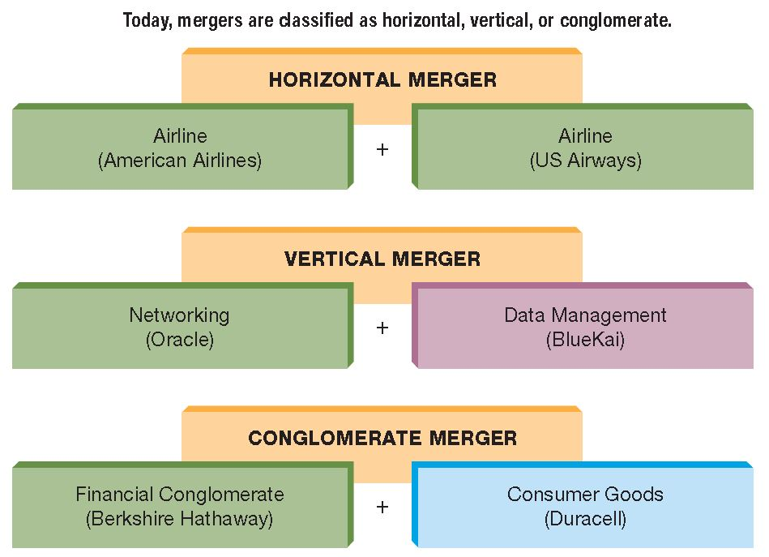
Three Types of Growth by Merger
FIGURE 4-5

Slide 36
Merger and Acquisition:
Pros and Cons
For Takeover
Can install a new top-management team
Forces the company to focus on one main business
Can reduce expenses
Makes company more profitable
Against Takeover
Does not enhance profitability or productivity
Only profits investment bankers, brokerage firms, and takeover “artists”
Notes:
Additional Resources
Website
Chicago Tribune
Mergers, Acquisitions, and Takeovers
http://www.chicagotribune.com/topic/economy-business-finance/companies-corporations/mergers-acquisitions-takeovers/04016005.topic
NY Times: Equity Firms Like Bain are Depicted as Colluding
9/11/2012
http://www.nytimes.com/2012/09/12/business/documents-depict-equity-firms-like-bain-as-colluding.html?pagewanted=all
The Quarterly Review of Economics and Finance
Stock market bubble effects on mergers and acquisitions
2010
http://web2.ono.ac.il/ShauserPublish/files/2011.1.pdf

Slide 37
Merger and Acquisition:
Trends for the Future
Experts predict...
Mergers after the economic crisis will be the result of cash-rich companies looking to enhance their position in the marketplace
There will be more mergers involving companies or investors from other countries
Future mergers and acquisitions will be driven by solid business logic and the desire to compete internationally

